Slide 1
FOOD supply Chain Management
Transforming the Global Food Supply Chain
Through Innovative Data Solutions

Slide 2






MEET THE TEAM
Nohori Jobaida
Iliyas Ahmed
Indronil Dey Niloy
Sadia Akter
1931154
2020365
2020339
2022719
Syed Shamsul Arefin
Ammarul Islam Anik
1931335
1910594

Slide 3
OUR Mission
Create a robust web application that revolutionizes the management of the global food supply chain. By harnessing innovative technologies, we aim to streamline data storage and tracking processes, ensuring transparency, efficiency, and sustainability throughout the entire food distribution network. Through this platform, we aspire to empower stakeholders to make informed decisions, optimize logistics, minimize waste, and ultimately contribute to a more resilient and accessible global food system.

Slide 4
About Our Project
Complex food supply chain needs better data management.
Global Food Supply Chain System tracks and stores data from farm to fork.
Centralized platform offers visibility and streamlines operations.
Farmers sell directly to customers, increasing transparency and income.
Real-time tracking identifies problems and improves responsiveness.
Data security and integrity are top priorities.
Easy-to-use interface caters to diverse users.
Goal: A more robust, transparent, and sustainable food system.
Supports global efforts for food security and reduced waste.
Join this transformative journey for a better future, one bite at a time.

Slide 5
PROBLEM STATEMENT
Data Integrity and Transparency.
Technological Challenges.
Social and Ethical Issues.
Sustainability.
Lack of Inclusivity.
Scalability Issues.

Slide 6
Research & Analysis
Economic Sustainability.
Environmental Sustainability.
Social Sustainability.
Challenges and Considerations.

Slide 7
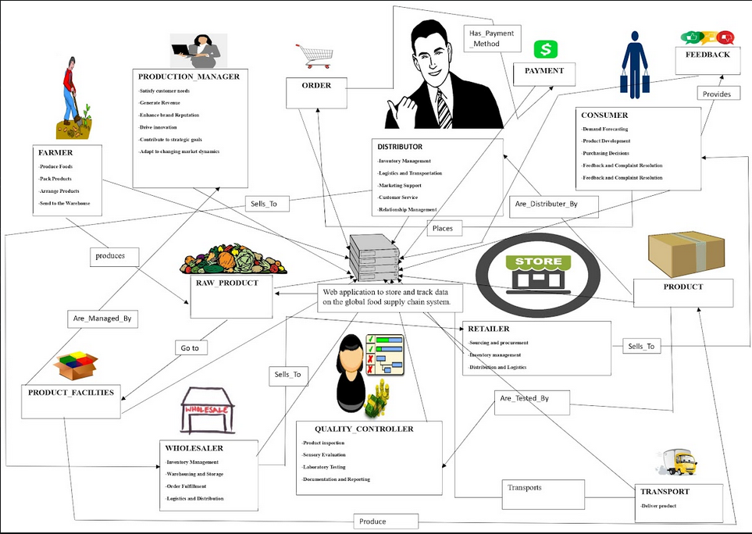
Rich Picture of Proposed System

Slide 8
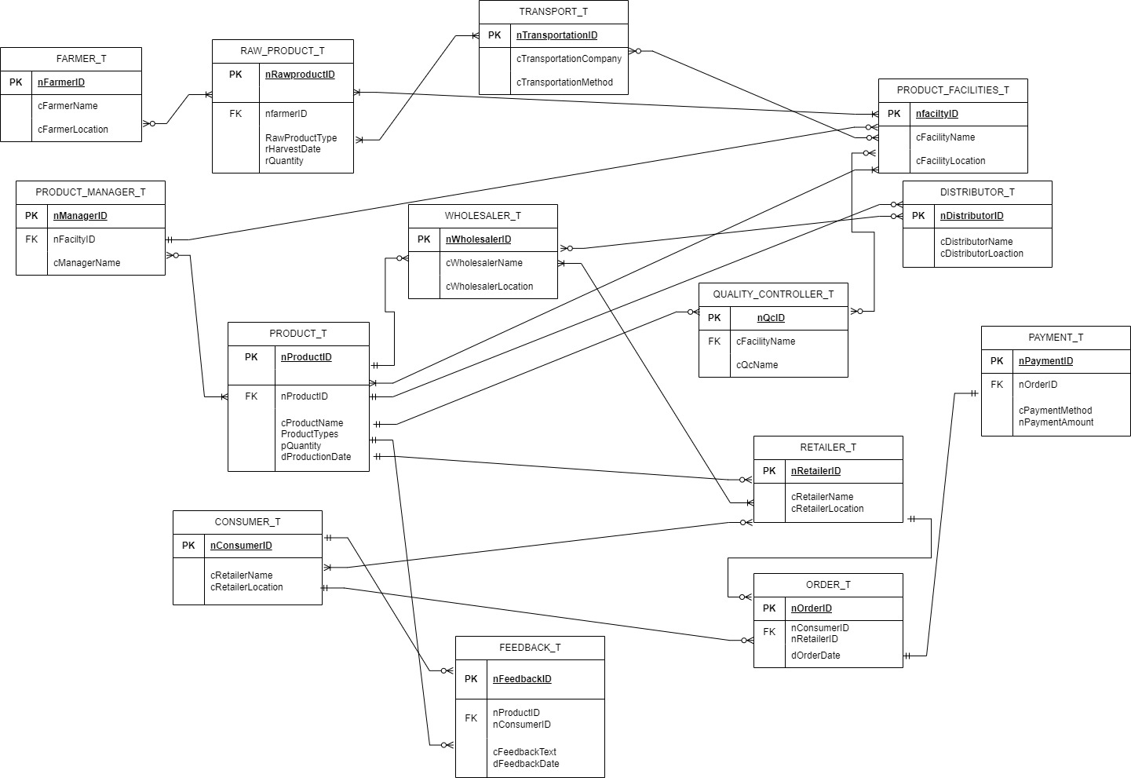
Entity Relation
Diagram

Slide 9
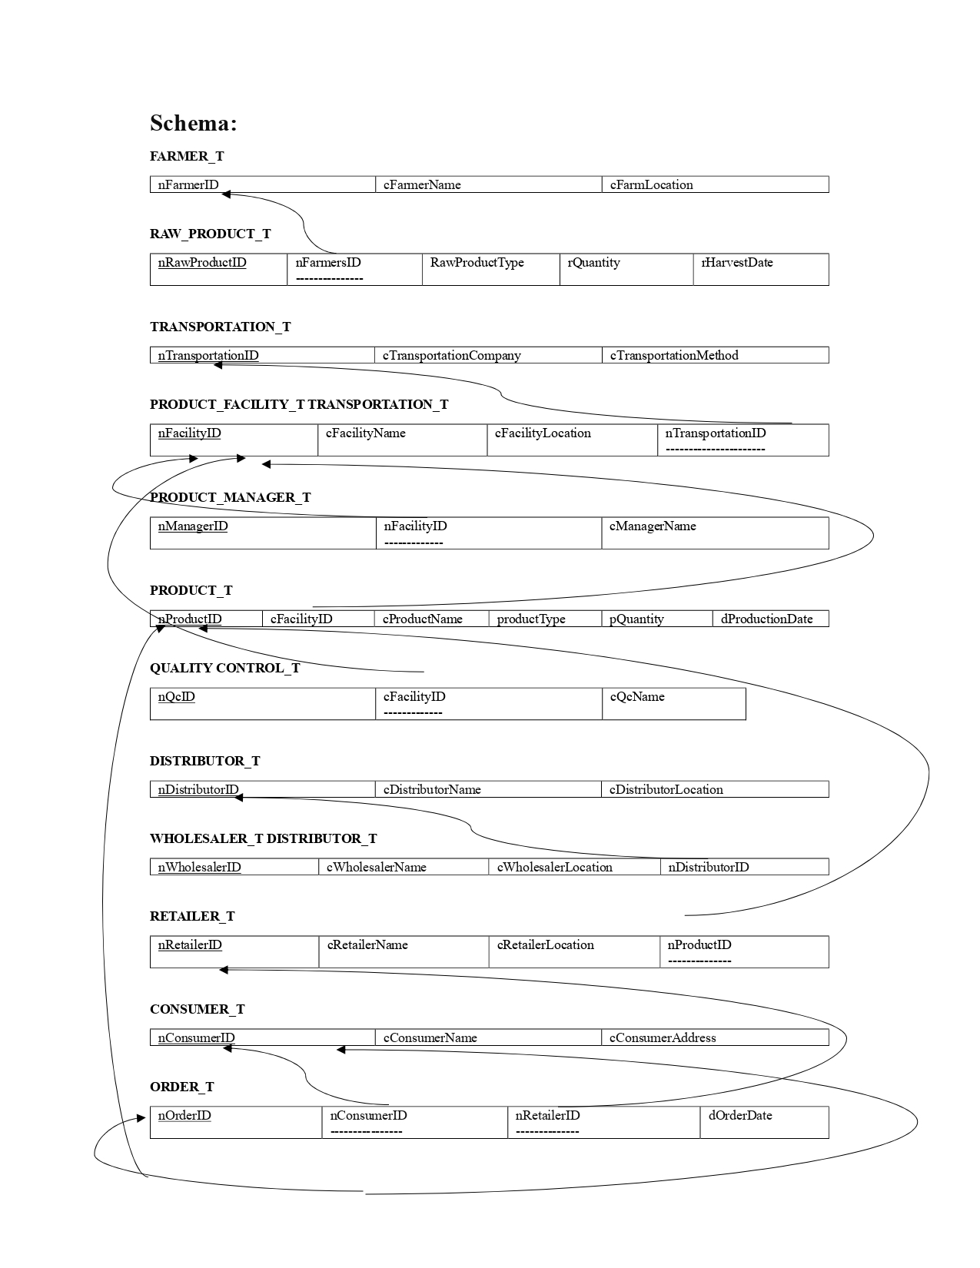
Relation
Schema

Slide 10
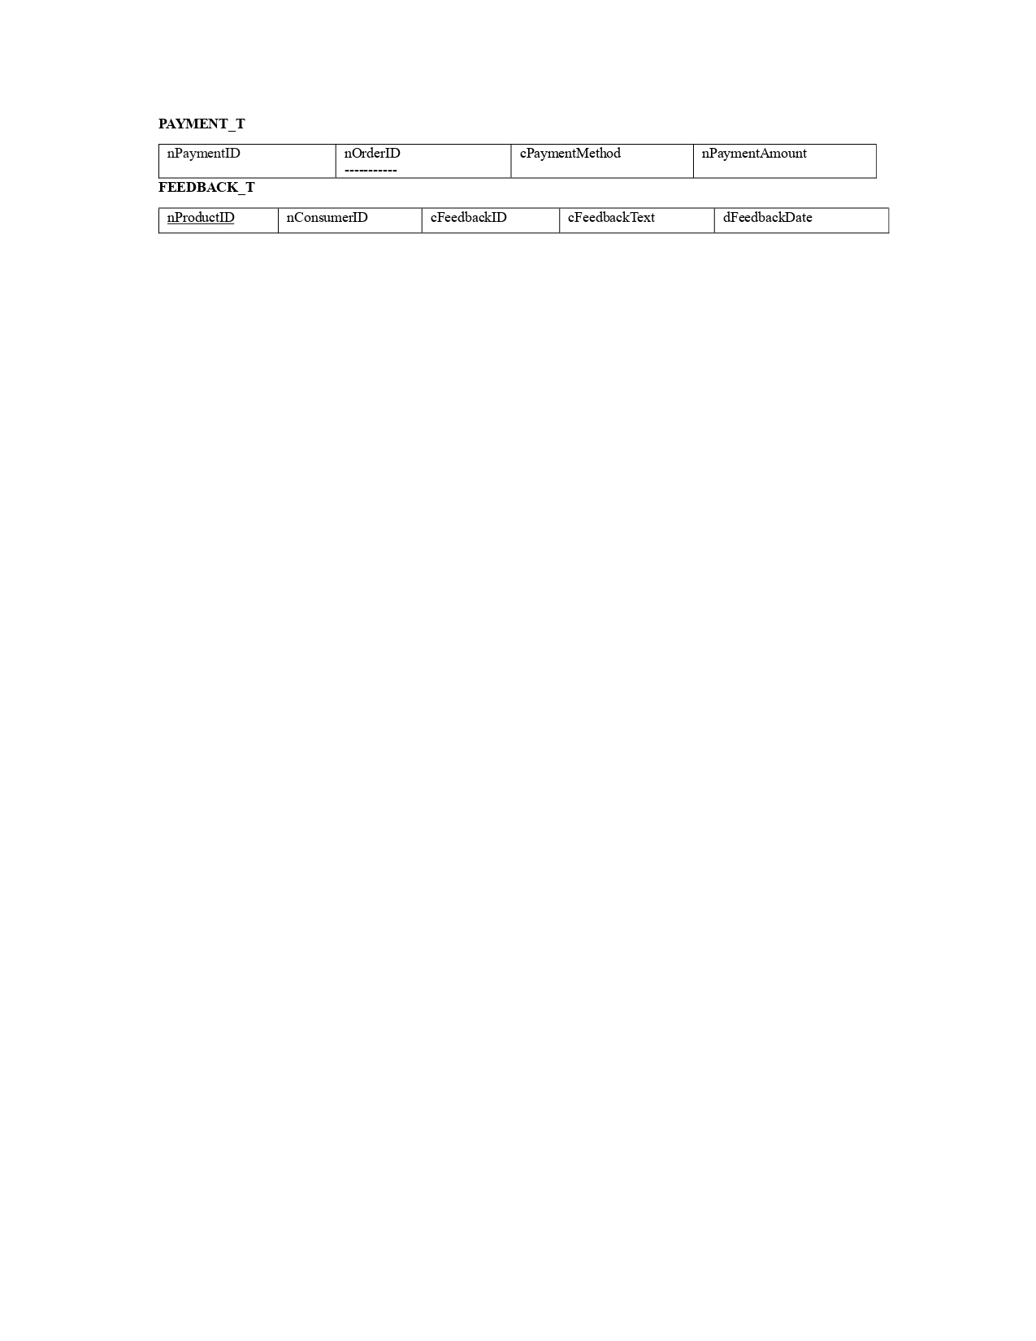
Relation
Schema

Slide 11
Normalization

Slide 12
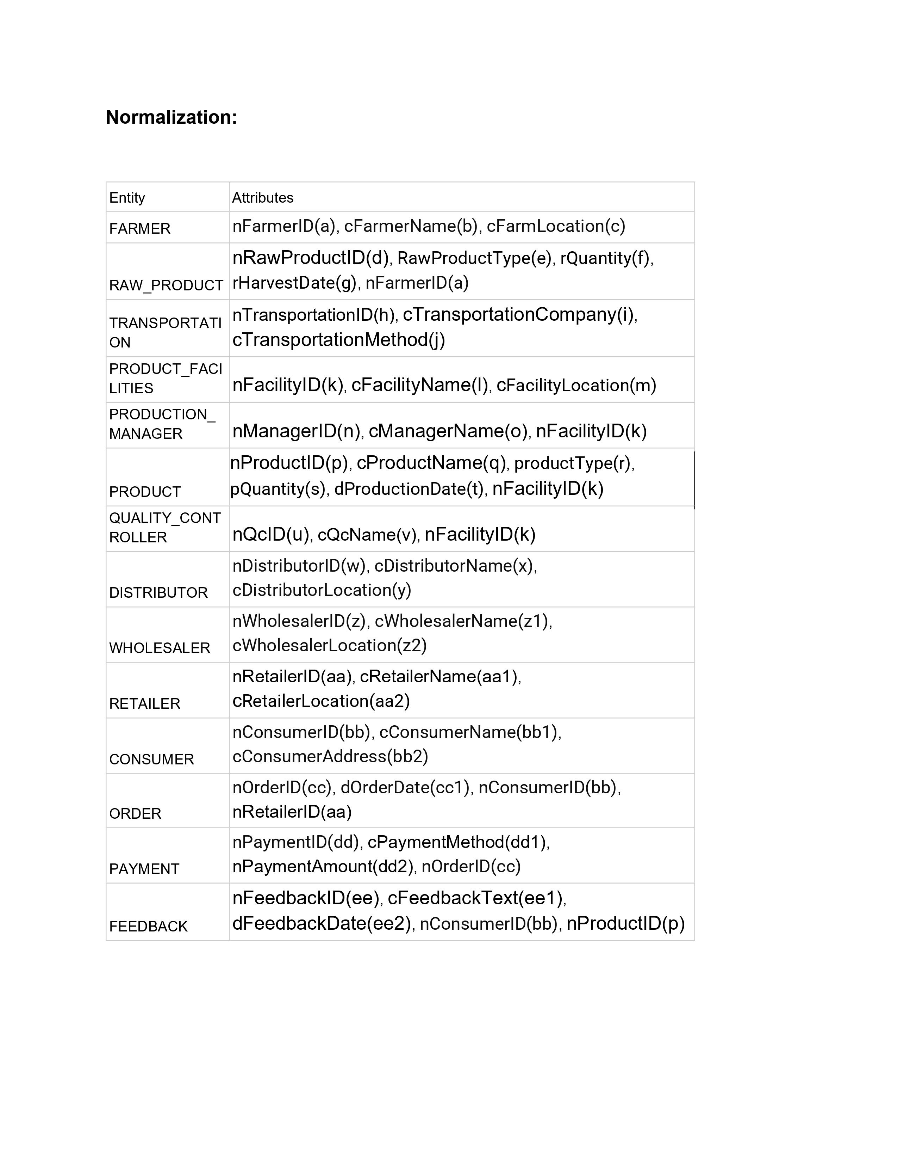
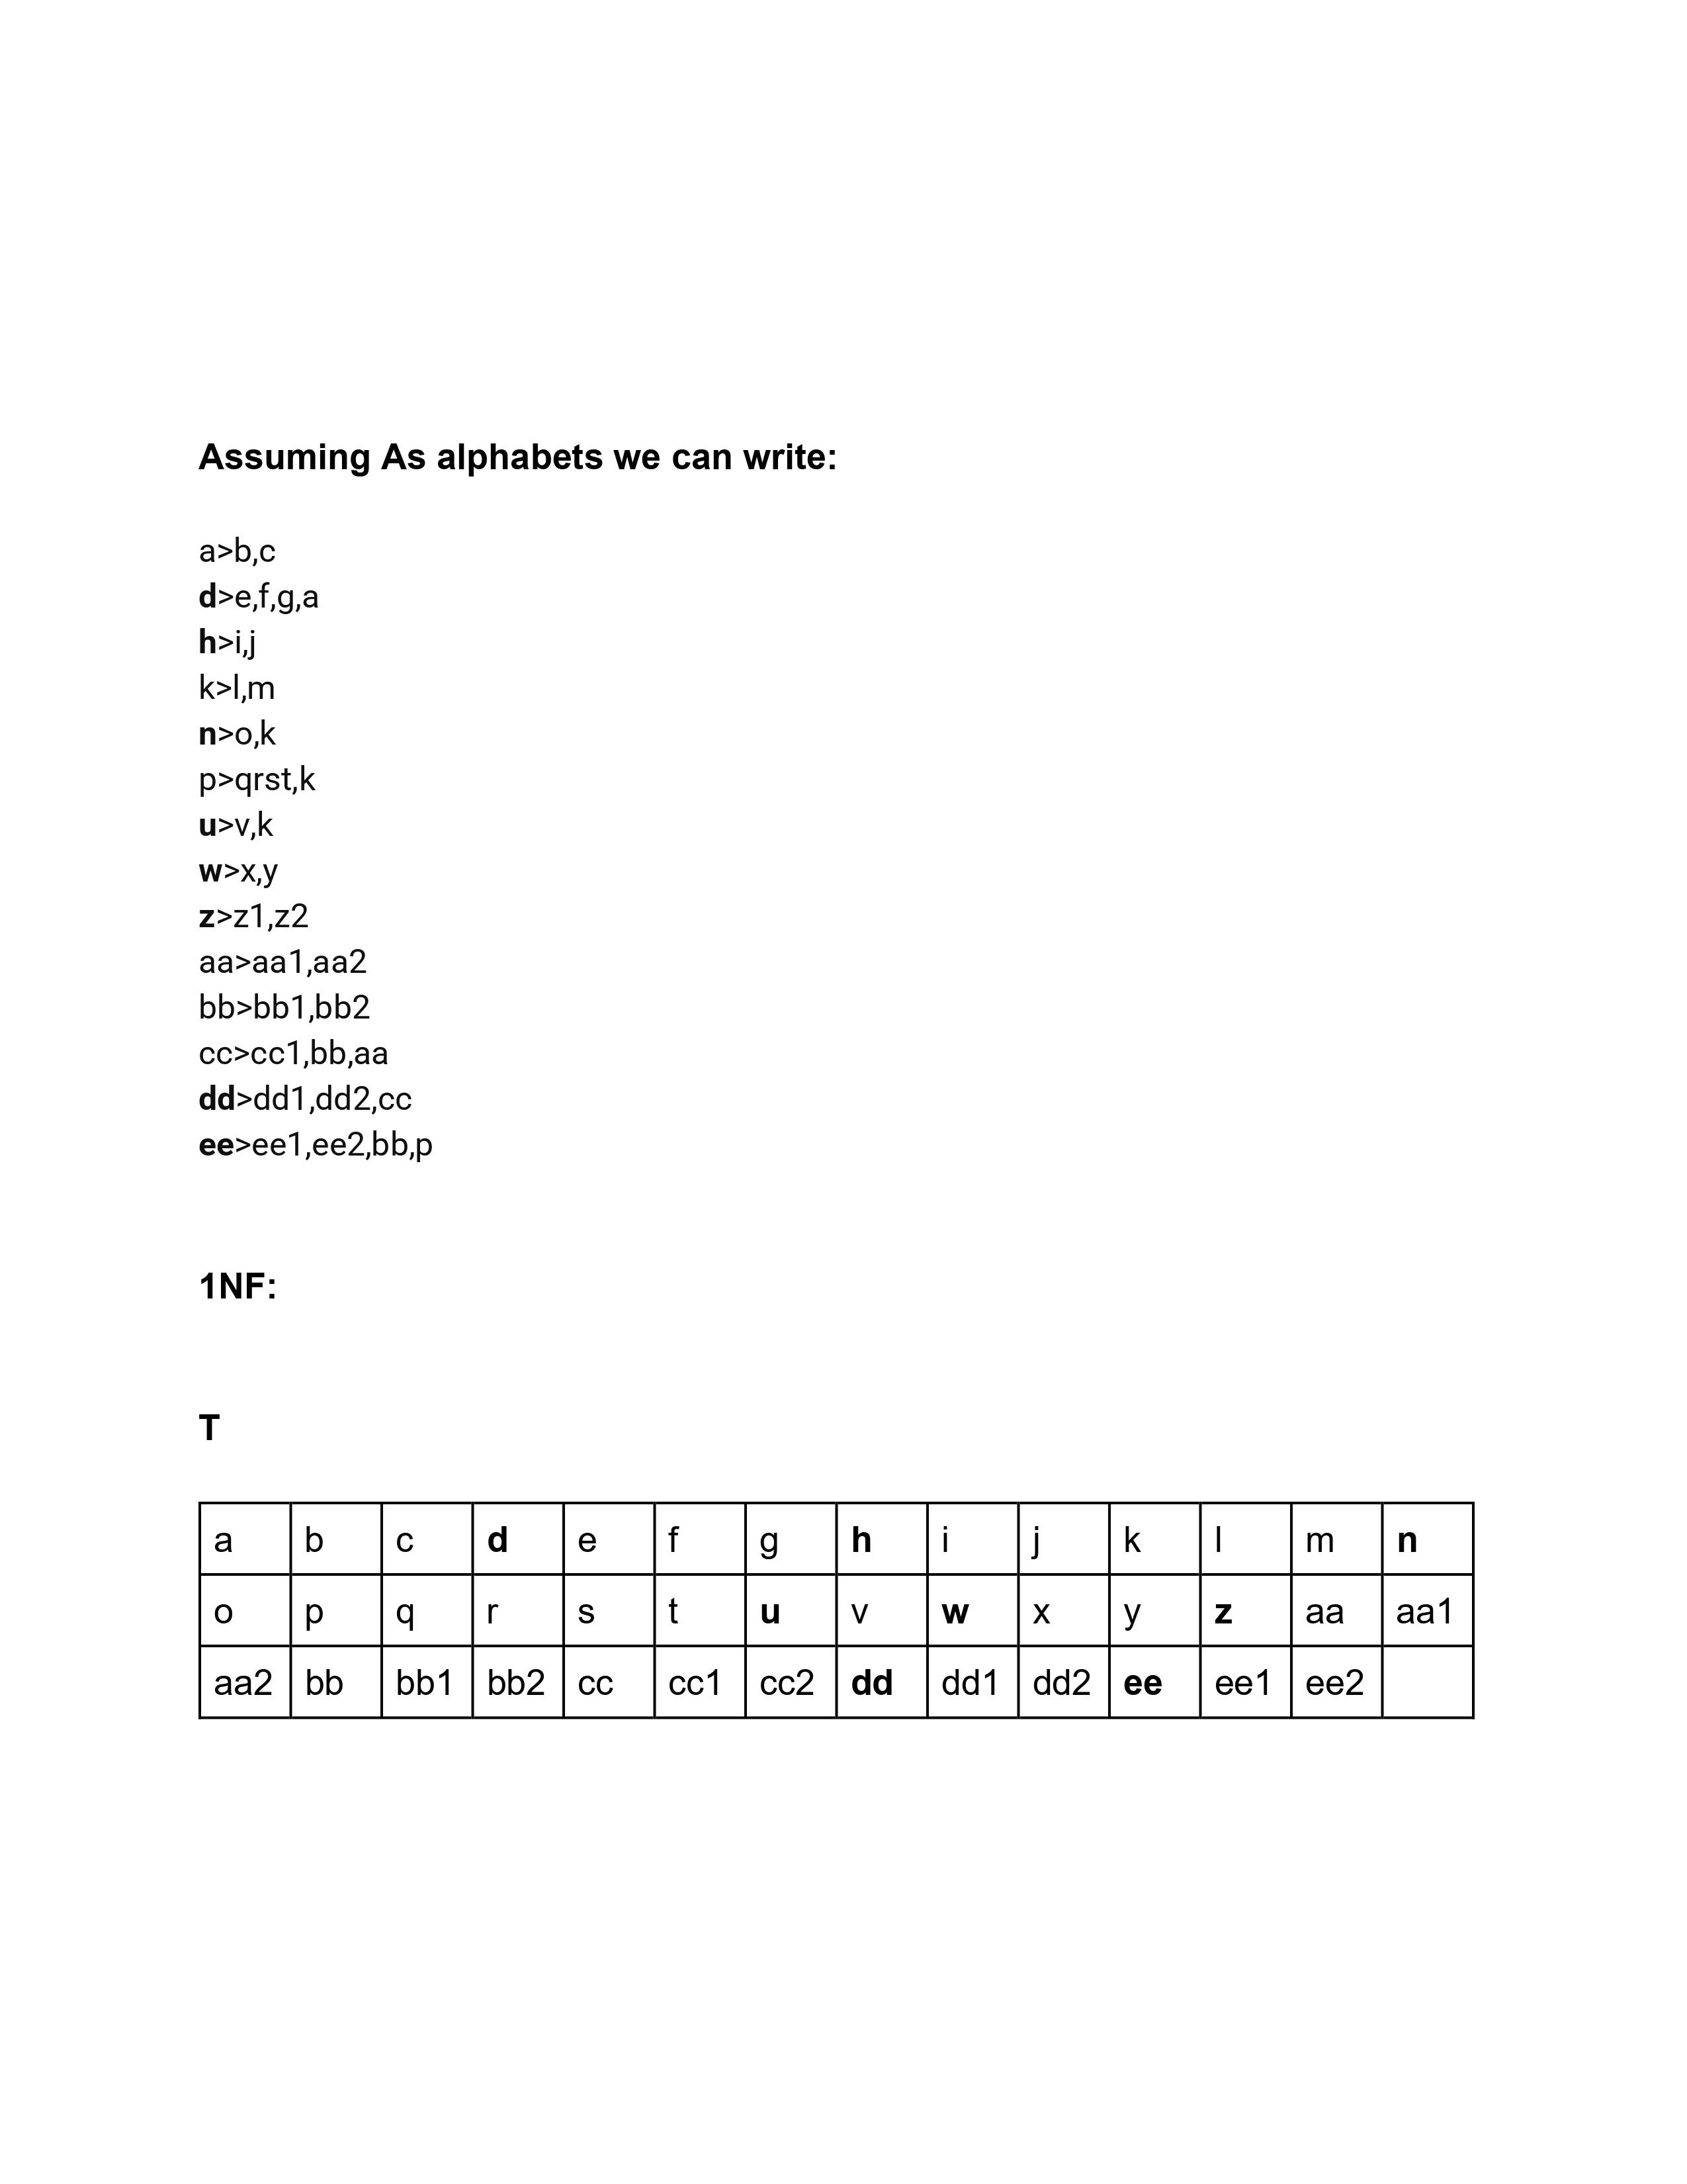

Slide 13
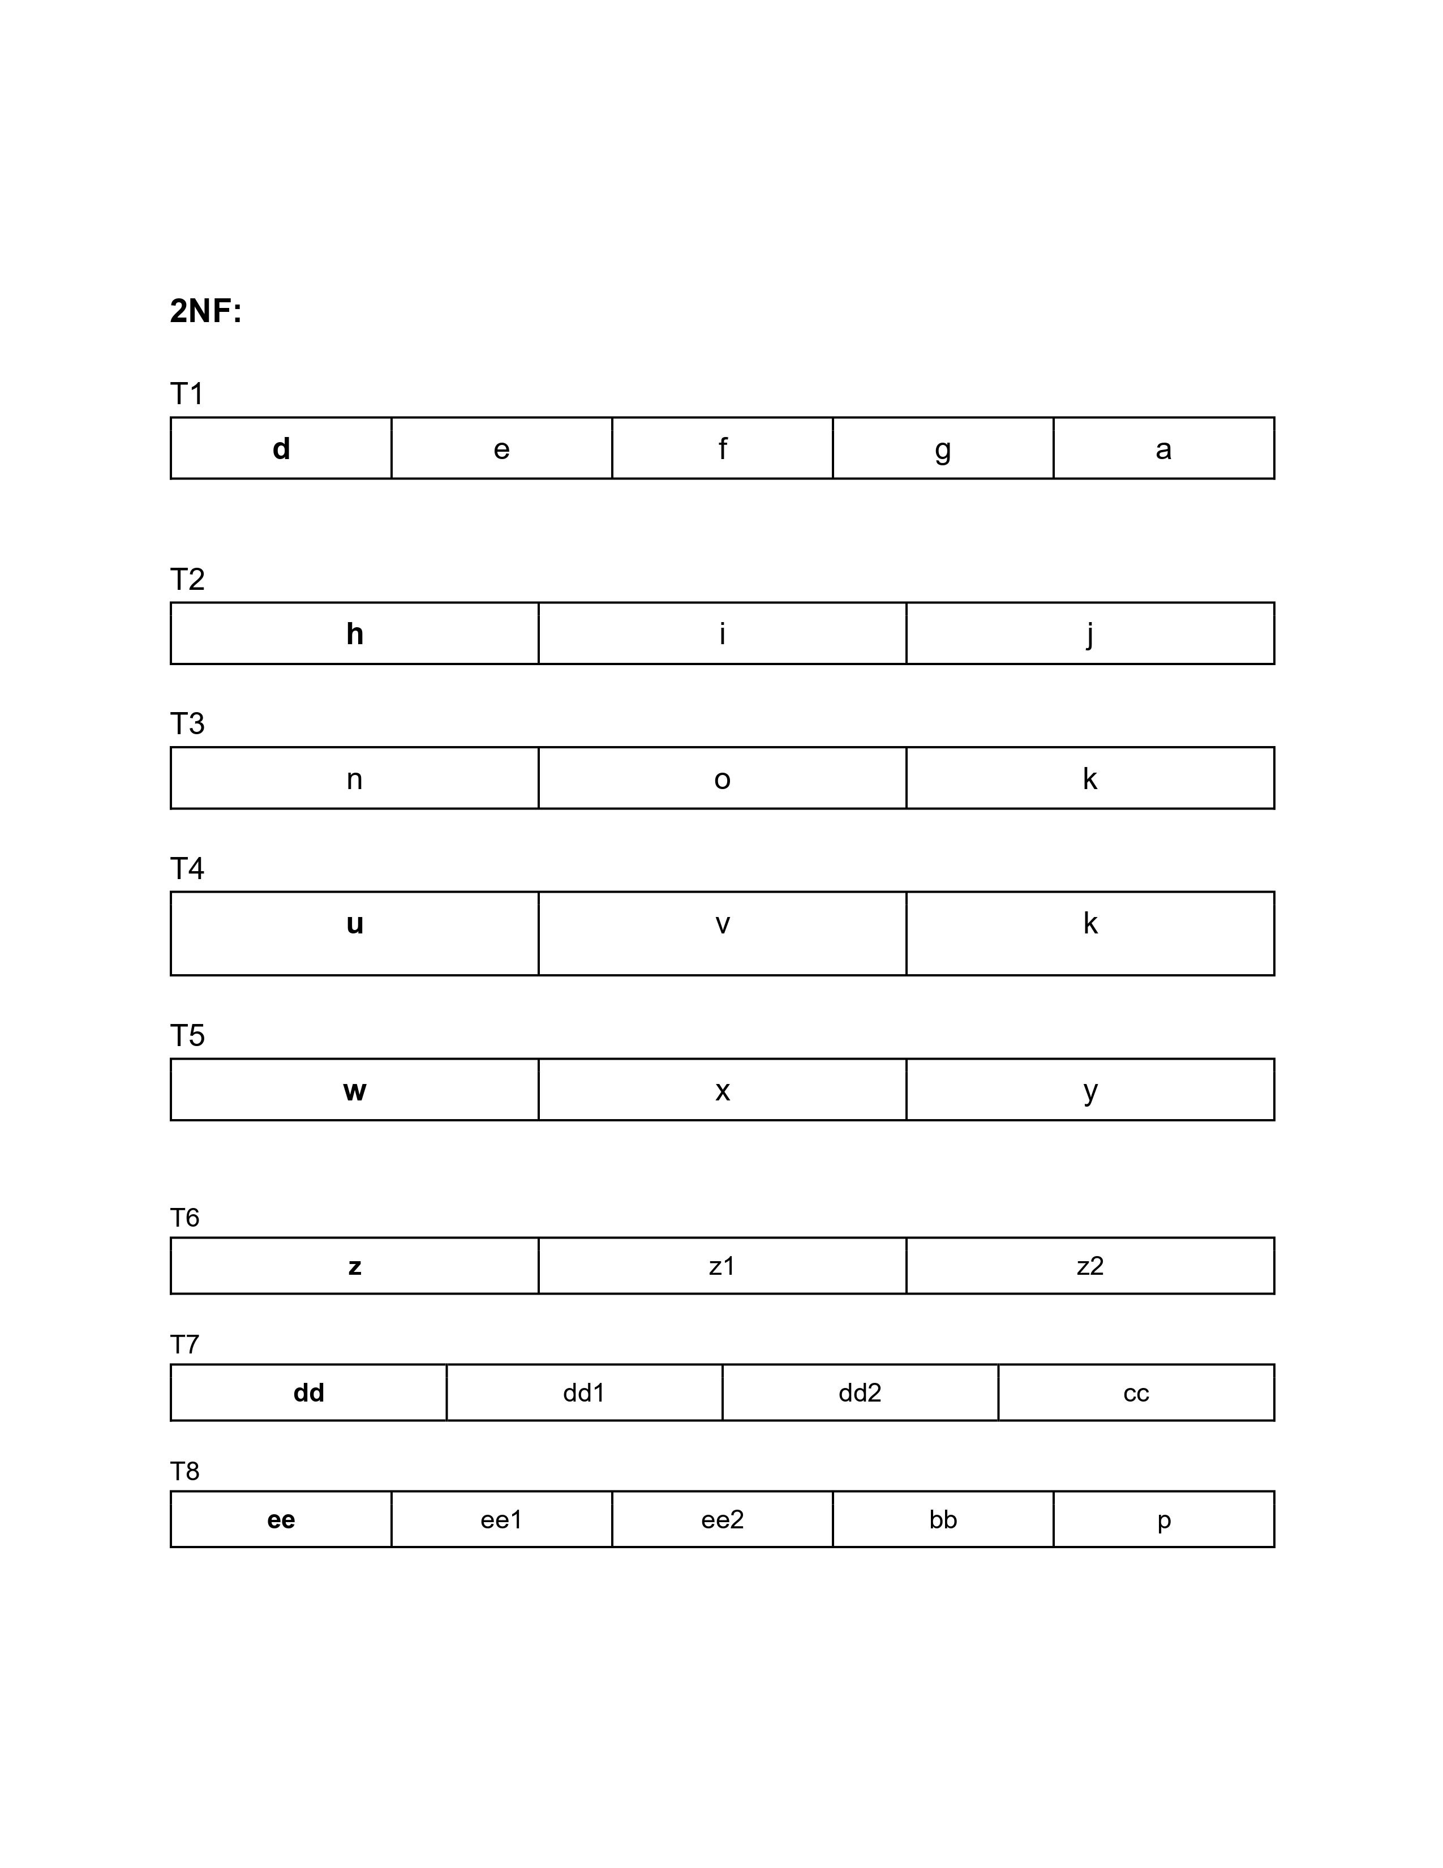
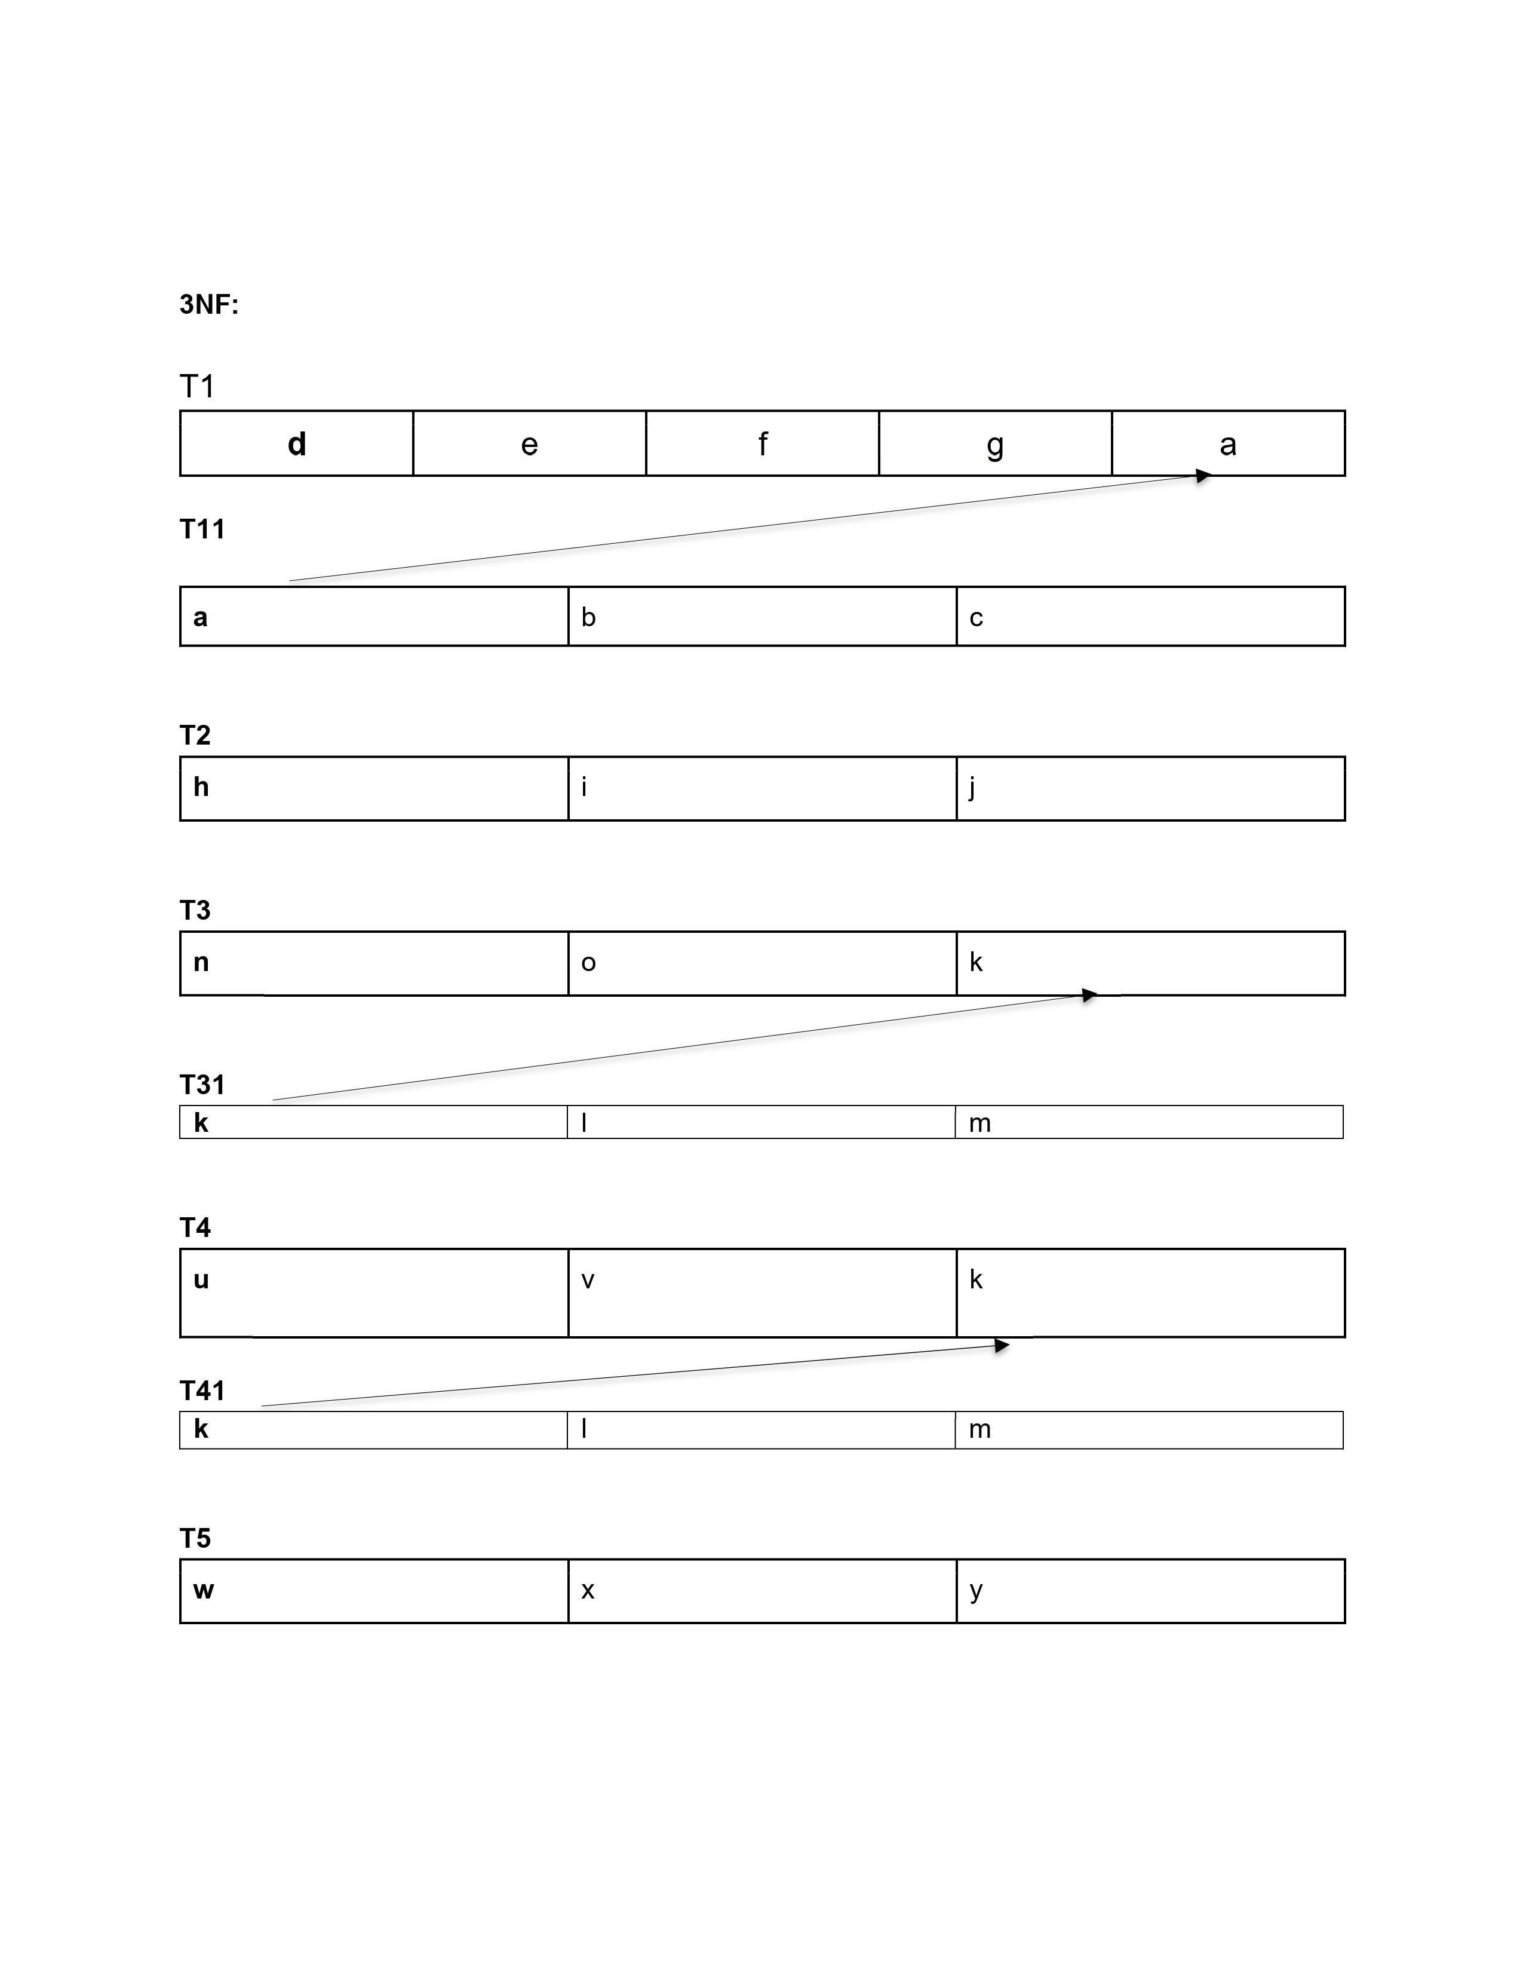

Slide 14
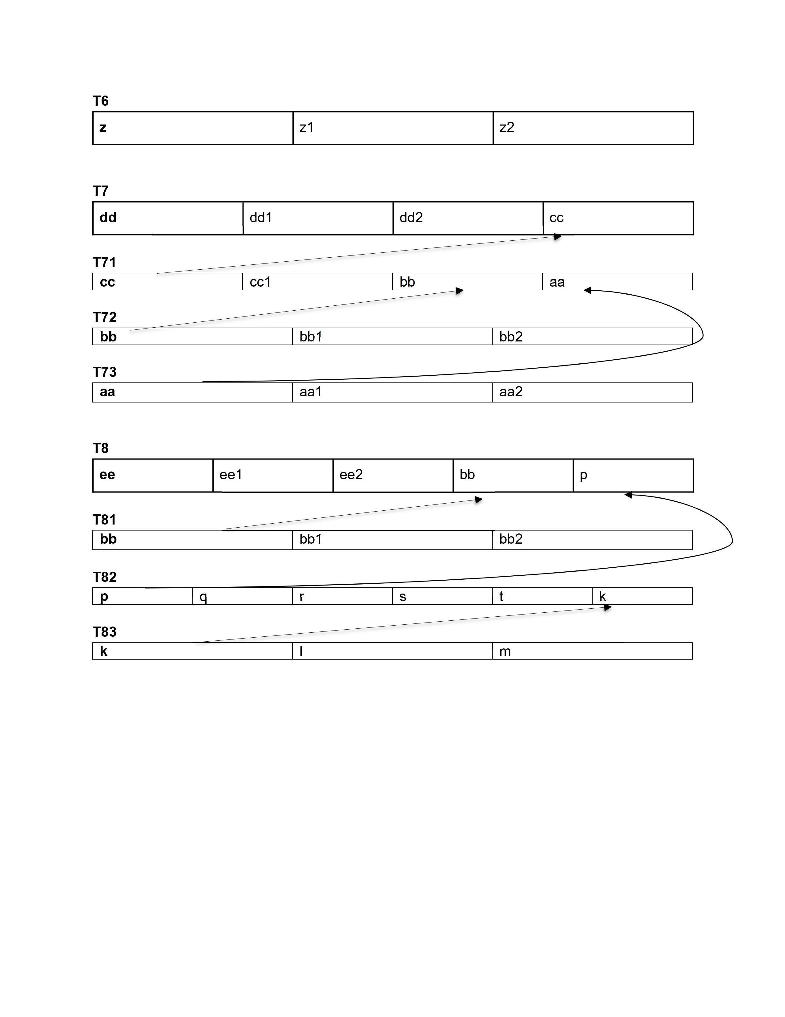

Slide 15
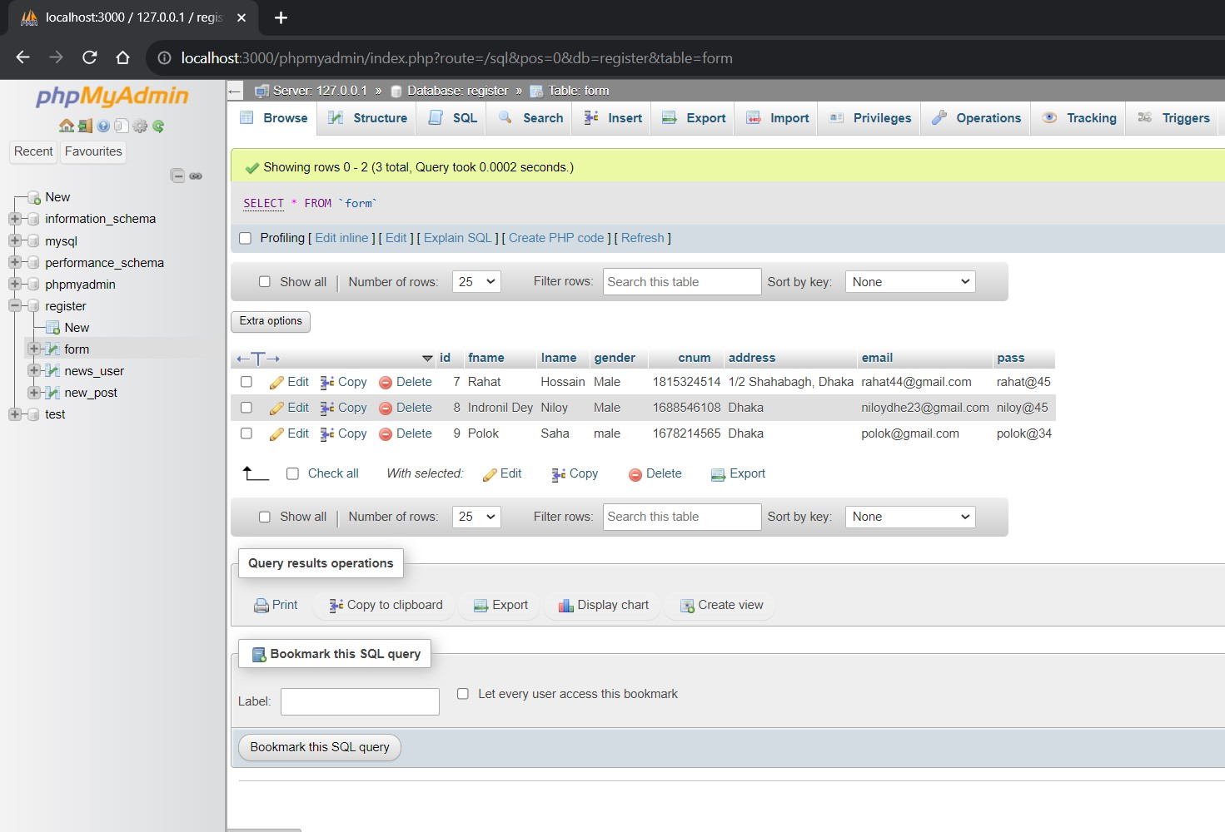
Implemented DAtabase
table

Slide 16
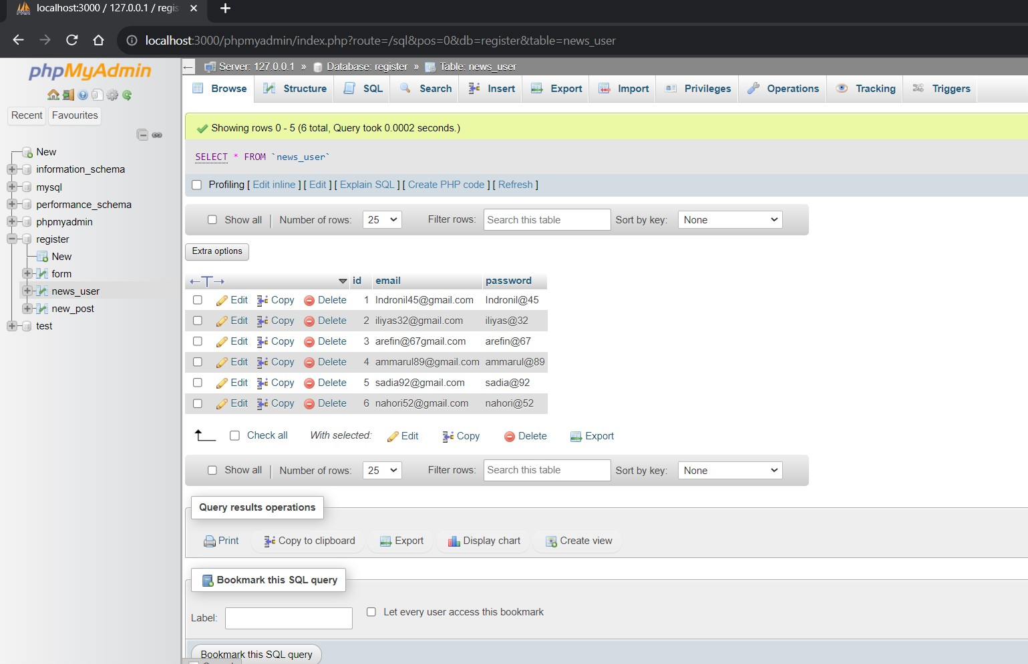

Slide 18
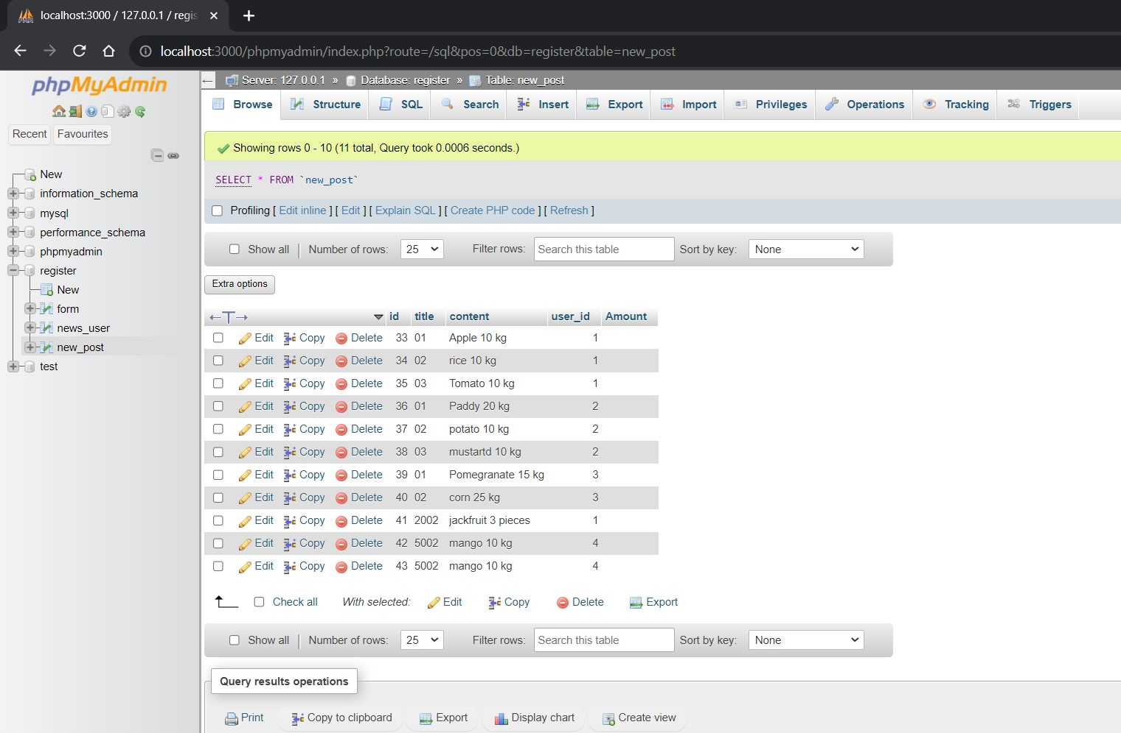

Slide 19
THANK YOU

